Slide 1

Code++
C++ Peer Learning Workshop
By C Square Club

Slide 2

Cout<<“Hello”;
Himanshu Gupta
2nd Year CSE
Joint Secretary
@C Square Club
LinkedIn - GeekyHim

Slide 3
Introduction to C++ Programming
The prime purpose of C++ programming is to add object orientation to the C programming language
The core of the pure object-oriented programming is to create an object, in code, that has certain properties and methods. While designing C++ modules, we try to see whole world in the form of objects.

Slide 4
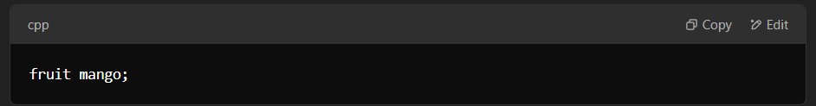
Understanding Classes in C++
A class is a user-defined data type that encapsulates data and functions into a single unit.
Once a class is defined, we can create multiple objects from it.
A class acts as a blueprint for creating objects of the same type.
The syntax for creating an object in C++ is similar to defining a variable in C.
Example:
If fruit is a defined class, then the following statement:
creates an object mango that belongs to the class fruit.

Slide 5
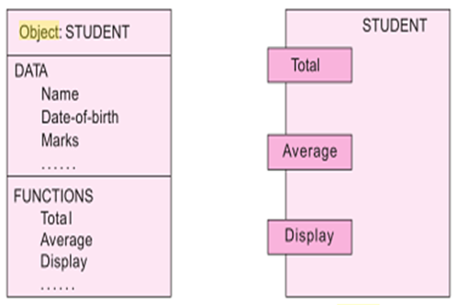
Object
Object is a instance of class.
Represent a person, a place, a bank account, a table of data or any item the program has to handle.

Slide 6
4 Basic Pillar of OOPs
Data Hiding
Abstraction
Encapsulation
Polymorphism
Inheritance

Slide 7
Data Hiding / Information Hiding
The process of restricting direct access to data within a program, ensuring data or information hiding.
Attributes refer to data members as they store information.
Functions are known as member functions as they operate on the data members.

Slide 8
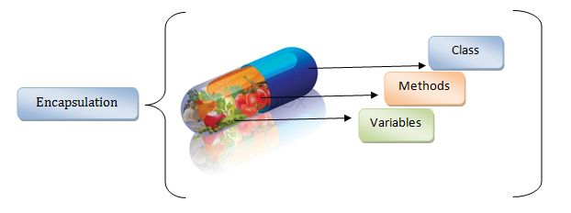
Encapsulation
Encapsulation: The process of bundling data and functions into a single unit
The data remains inaccessible to the outside world.
Only functions within the class can access and manipulate the data.
Fig.2. Encapsulation

Slide 9
Abstraction:
The concept of showcasing essential features while hiding the underlying implementation details.

Slide 10
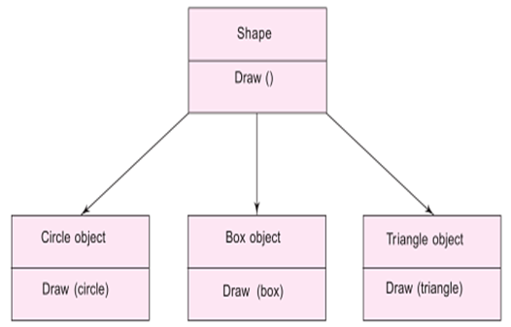
Polymorphism
The ability of an entity to take multiple forms.
An operation can behave differently in different instances.
Fig. 5. Polymorphism

Slide 11
Function Overloading.
When a single function name is used to perform multiple tasks, it is known as function overloading.
HANDS-ON

Slide 12
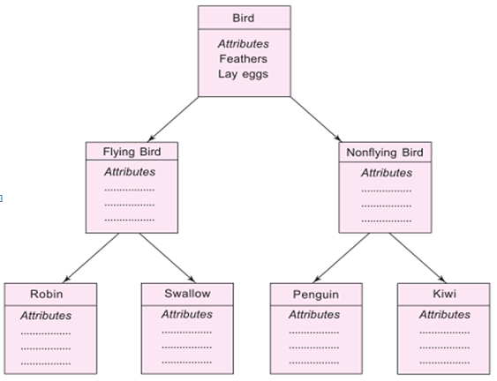
Inheritance
Process by which objects of one class acquire the properties of objects of another class.
Each derived class shares common characteristics with the class from which it is derived.
Inheritance provides reusability and expandability.
Fig. 4. Property Inheritance

Slide 13
Difference between object oriented and procedure-oriented programming
Procedure-oriented programming | Object-oriented programming
Emphasis is on doing things. | Emphasis is on data rather than procedure.
Large programs divided into smaller functions. | Programs are divided into objects.
Functions can share global data. | Functions that operate on the data of an object are tied together in the data structure.
Data move openly. | Data is hidden.
Functions transform data from one form to another. | Objects may communicate with each other through functions.
Top-down approach in program design. | Bottom-up approach in program design.

Slide 14
Input and output stream (cin, cout)
C++ comes with libraries that provide us with many ways for performing input and output. In C++ input and output are performed in the form of a sequence of bytes or more commonly known as streams.
Input Stream: If the direction of flow of bytes is from the device(for example, Keyboard) to the main memory then this process is called input.
Output Stream: If the direction of flow of bytes is opposite, i.e. from main memory to device( display screen ) then this process is called output.

Slide 15
Header files available in C++ for Input/Output operations are:
iostream: iostream stands for standard input-output stream. This header file contains definitions to objects like cin, cout, cerr etc.
iomanip: iomanip stands for input output manipulators. The methods declared in this files are used for manipulating streams. This file contains definitions of setw, setprecision, etc.
fstream: This header file mainly describes the file stream. This header file is used to handle the data being read from a file as input or data being written into the file as output.
The two keywords cout and cin in C++ are used very often for printing outputs and taking inputs respectively. These two are the most basic methods of taking input and printing output in C++. To use cin and cout in C++ one must include the header file iostream in the program.

Slide 16
Namespace
Namespaces provide a method for preventing name conflicts in large projects.
Symbols declared inside a namespace block are placed in a named scope that prevents them from being mistaken for identically-named symbols in other scopes.
Multiple namespace blocks with the same name are allowed. All declarations within those blocks are declared in the named scope.

Slide 17
Defining a Namespace
A namespace definition begins with the keyword namespace followed by the namespace name as follows −
namespace namespace_name { // code declarations }
To call the namespace-enabled version of either function or variable, prepend (::) the namespace name as follows −
name::code; // code could be variable or function.

Slide 18
The using directive
You can also avoid prepending of namespaces with the using namespace directive. This directive tells the compiler that the subsequent code is making use of names in the specified namespace.
The ‘using’ directive can also be used to refer to a particular item within a namespace. For example, if the only part of the std namespace that you intend to use is cout, you can refer to it as follows −
using std::cout;

Slide 19
Defining a Member function outside the class
If we define the member function outside the class definition then we must declare
the function inside class definition and then define it outside.
The definition of member function outside the class differs from normal function
Definition
Scope resolution operator (: :)
The scope resolution operator informs the compiler what class the member belongs
The syntax for defining a member function outside the class
return_type class_name :: function_name (parameter_list)
{
// body of the member function
}

Slide 20
ACCESS MODIFIERS
Private
A member data can only be accessed by the member functions and friends of this class.
The member functions of this class can always read or write private data members.
Private data members is not accessible to the outside world.
Public
Can be accessed by any function in the outside world.
Protected
Members can only be accessed by member functions and friends of this class.
Not accessible to the outside world

Slide 21
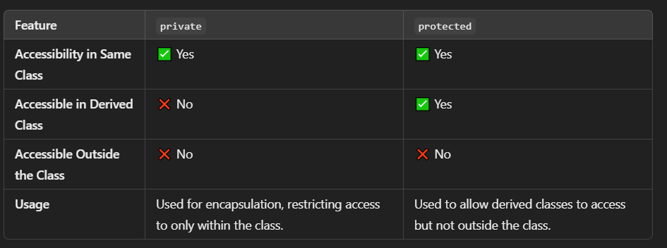
ACCESS MODIFIERS

Slide 22
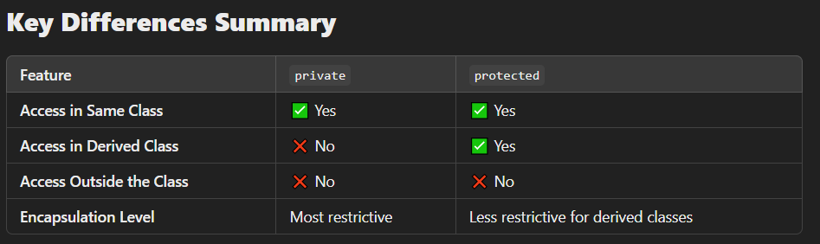
ACCESS MODIFIERS

Slide 23
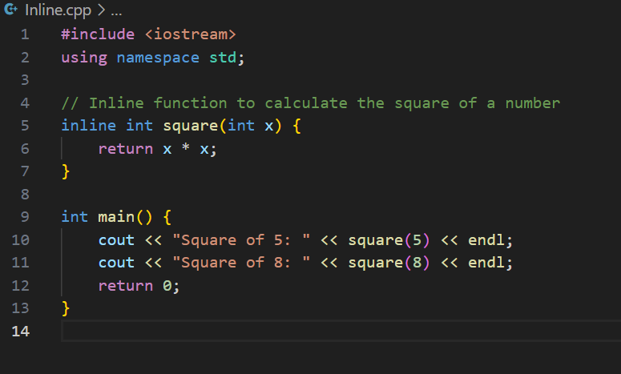
INLINE FUNCTIONS
Inline Functions in C++
An inline function is a function that is expanded at the point of its call, rather than executing a separate function call. It is a request to the compiler (not a command), which replaces the function call with the actual function code to reduce function call overhead.

Slide 24
Advantages of Inline Functions:
Reduces Function Call Overhead: Since the function code is substituted at the call location, there is no need for function stack operations.
Increases Execution Speed: Eliminates the overhead of function calls, making execution faster.
Better Optimization: The compiler can optimize the function code better due to direct code substitution.
Helps in Small Functions: Ideal for small, frequently used functions.
Limitations of Inline Functions:
The compiler may ignore the inline request if the function is too complex (e.g., contains loops, static variables, or recursion).
Increases the size of the binary executable (code bloating) if overused.

Slide 25
When NOT to Use Inline Functions:
If the function is large, using inline will increase code size (code bloating).
If the function contains loops, static variables, or recursion, the compiler will ignore the inline request.
If the function is rarely called, making it inline has no real advantage.
Conclusion:
Use inline functions for small, frequently used functions to improve efficiency.
Avoid using inline functions for complex functions as they may increase binary size and reduce maintainability.

Slide 26
Pointer in C++
What is a Pointer?
A pointer is a special type of variable that stores the memory address of another variable instead of storing a direct value. Pointers are one of the most powerful features in C++ as they enable direct memory manipulation.
Why Use Pointers?
Efficient Memory Management: Helps in dynamic memory allocation.
Function Argument Passing (Pass by Reference): Allows functions to modify actual variables.
Data Structures Implementation: Used in linked lists, trees, graphs, and dynamic arrays.
Optimized Performance: Reduces memory consumption and speeds up operations.

Slide 27
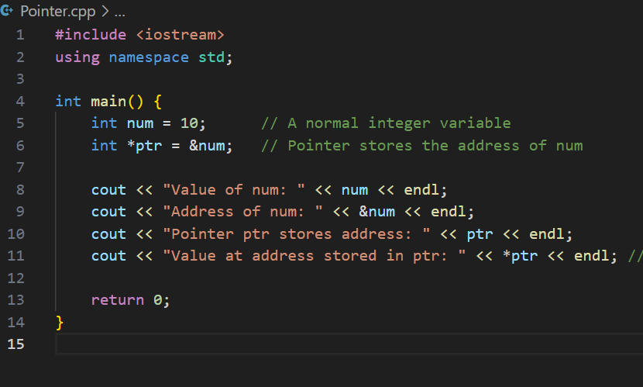

Slide 28
What is a Constructor?
A constructor is a special member function in C++ that is automatically called when an object of a class is created. It is used to initialize objects.
Key Characteristics of Constructors:
Same Name as Class – A constructor must have the same name as the class.
No Return Type – Constructors do not have a return type (not even void).
Automatically Called – They are invoked automatically when an object is instantiated.
Can Be Overloaded – Multiple constructors can exist in the same class (Constructor Overloading).
Can Be Parameterized – Constructors can take arguments to initialize an object.

Slide 29
Types of Constructors
1. Default Constructor (No Parameters)
A default constructor is a constructor that takes no parameters and initializes an object with default values.
2. Parameterized Constructor
A parameterized constructor allows passing values to initialize an object.
3. Copy Constructor
A copy constructor creates a new object as a copy of an existing object.

Slide 30
What is a Destructor?
A destructor is a special member function in C++ that is automatically called when an object goes out of scope or is explicitly deleted. It is used to release resources (such as memory, files, or database connections) that were allocated during the object's lifetime.
Key Characteristics of a Destructor:
Same Name as Class, Prefixed with ~
No Parameters and No Return Type
Automatically Invoked
One Destructor per Class
Destructors are useful for releasing memory and closing resources.
They prevent memory leaks in programs that use dynamic memory allocation.
Each object calls its destructor automatically at the end of its lifecycle.

Slide 31
INHERITENCE
Inheritance is a fundamental concept in Object-Oriented Programming (OOP) that allows a new class (child/derived class) to inherit properties and behaviors (variables and functions) from an existing class (parent/base class).
Why use Inheritance?
Promotes code reusability.
Establishes a hierarchical relationship between classes.
Enhances extensibility (easy to add new features).

Slide 32
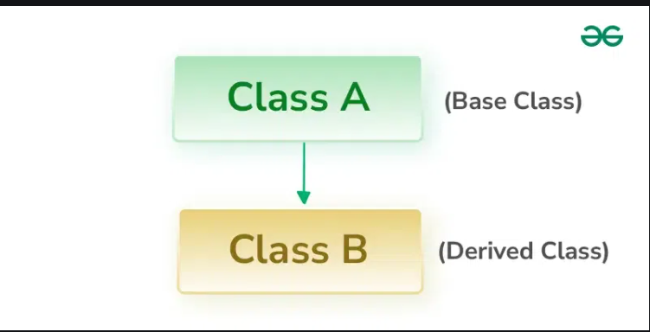
Single Level

Slide 33
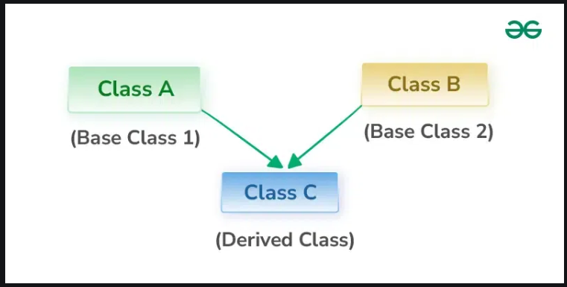
Multiple

Slide 34
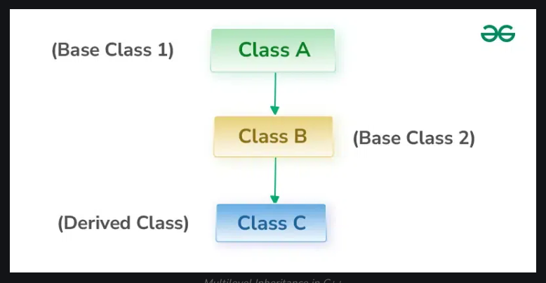
Multi Level

Slide 35
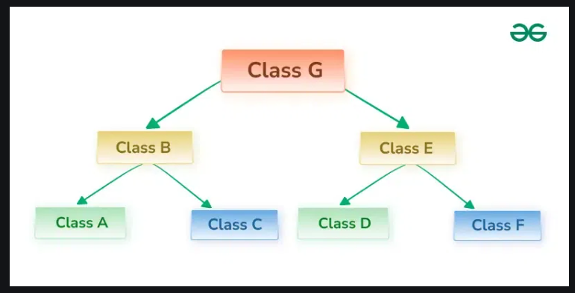
Hierarchical

Slide 36
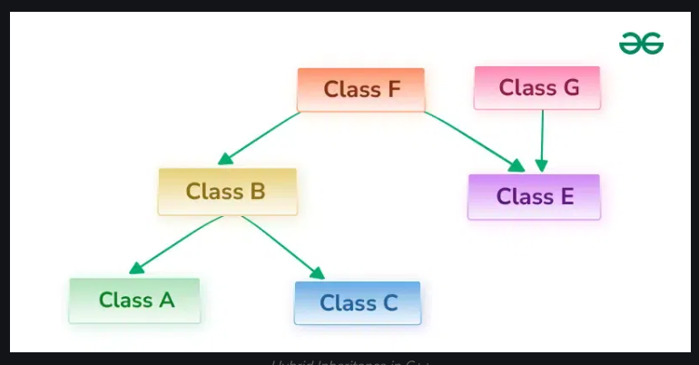
Hybrid

Slide 37
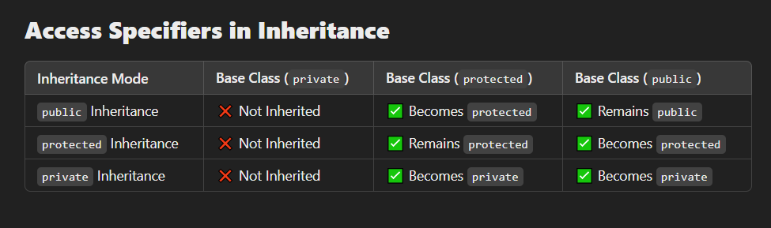
Impact by Access Modifiers

